Slide 1

Sentimental Analysis of Twitter comments using Apache Pig
Guided By:- Submitted By:-
Dr. Dharavath Ramesh Aman Rathore (15JE001292)
Shantanu Sarin (15JE001824)

Slide 2
What is Sentiment Analysis?
It is classification of the polarity of a given text in the document, sentence or phrase.
The goal is to determine whether the expressed opinion in the text is positive, negative or neutral.

Slide 3
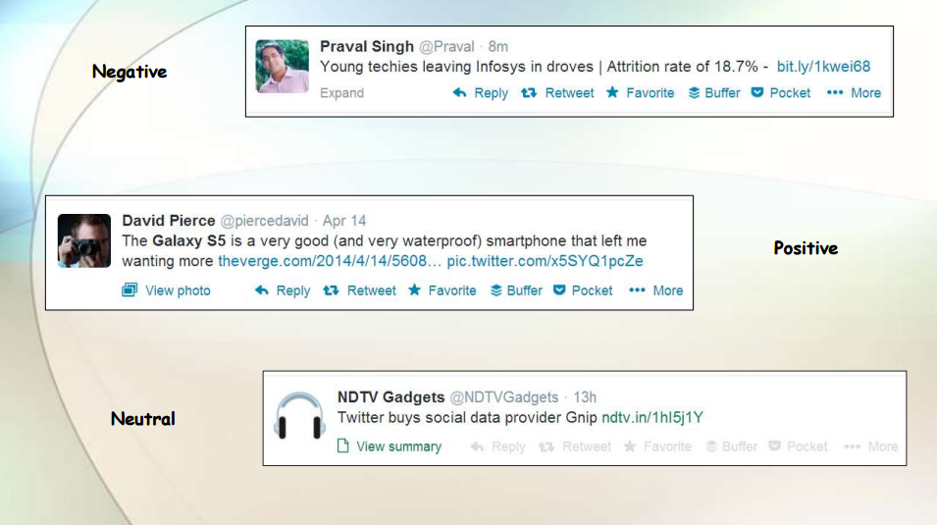
Polarity of tweets

Slide 4
Why is Sentiment Analysis Important?
Micro-blogging has become popular communication tool.
Opinion of the mass is important.
Political party may want to know whether people support their program or not.
Before investing into a company, one can leverage the sentiment of the people for the company to find out where it stands.
A company might want find out the reviews of its products.

Slide 5
Problem Statement
Given the tweets generated after the onset of demonetization, classify each tweet as positive, negative or neutral.
For messages conveying both a positive and negative sentiment, stronger one is chosen.

Slide 6
What is Apache Pig ?
Apache Pig is an abstraction over MapReduce. It is a tool/platform which is used to analyze larger sets of data representing them as data flows. Pig is generally used with Hadoop. We can perform all the data manipulation operations in Hadoop using Apache Pig.
To write data analysis programs, Pig provides a high-level language known as Pig Latin. This language provides various operators using which programmers can develop their own functions for reading, writing, and processing data.

Slide 7
To analyze data using Apache Pig, programmers need to write scripts using Pig Latin language.
All these scripts are internally converted to Map and Reduce tasks.
Apache Pig has a component known as Pig Engine that accepts the Pig Latin scripts as input and converts those scripts into MapReduce jobs.

Slide 8
Why Do We Need Apache Pig?
Using Pig Latin, programmers can perform MapReduce tasks easily without having to type complex codes in Java.
Apache Pig uses multi-query approach, thereby reducing the length of codes. For example, an operation that would require you to type 200 lines of code (LoC) in Java can be easily done by typing as less as just 10 LoC in Apache Pig.
Pig Latin is SQL-like language.

Slide 9
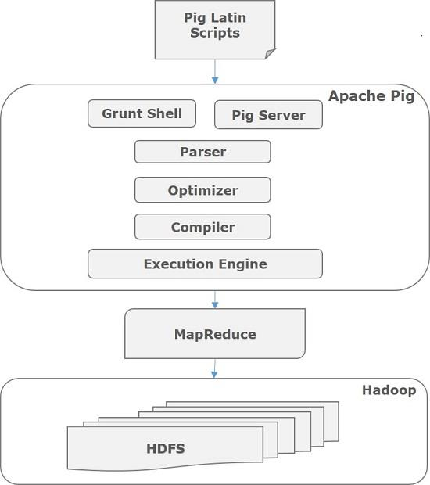
Apache Pig – Architecture

Slide 10
What is Flume?
Apache Flume is a tool/service/data ingestion mechanism for collecting aggregating and transporting large amounts of streaming data such as log files, events (etc...) from various sources to a centralized data store.
Assume an e-commerce web application wants to analyze the customer behavior from a particular region. To do so, they would need to move the available log data in to Hadoop for analysis. Here, Apache Flume comes to our rescue.

Slide 11
STEPS :
We used flume to download the tweets data from www.twitter.com and directly transfering it to the HDFS.
The data is then loaded to Pig using the following command “load_tweets = LOAD '/demonetization-tweets.csv' USING PigStorage(',');”
Then we extract the id and tweet_text as follows: “extract_details = FOREACH load_tweets GENERATE $0 as id,$1 as text;”

Slide 12
Now we will divide the tweet_text into words to calculate the sentiment of the whole tweet.
“tokens = foreach extract_details generate id,text, FLATTEN(TOKENIZE(text)) As word;”
Now, we have to analyse the Sentiment for the tweet by using the words in the text. We will rate the word as per its meaning from +5 to -5 using the dictionary AFINN. The AFINN is a dictionary which consists of 2500 words which are rated from +5 to -5 depending on their meaning.
We will load the dictionary into pig by using the below statement:
“dictionary = load '/AFINN.txt' using PigStorage('\t') AS(word:chararray,rating:int); “
Now, let’s perform a map side join by joining the tokens statement and the dictionary contents using this relation:
“word_rating = join tokens by word left outer, dictionary by word using 'replicated';”

Slide 13
Now we will extract the id,tweet text and word rating(from the dictionary) by using the below relation. rating = foreach word_rating generate tokens::id as id,tokens::text as text, dictionary::rating as rate;
Now, we will group the rating of all the words in a tweet by using the below relation: word_group = group rating by (id,text);
Now, let’s perform the Average operation on the rating of the words per each tweet. avg_rate = foreach word_group generate group, AVG(rating.rate) as tweet_rating;
Now we will filter the positive tweets using the below statement: positive_tweets = filter avg_rate by tweet_rating>=0;
Like this we will also filter the negative tweets as follows: negative_tweets = filter avg_rate by tweet_rating<0;

Slide 14
Conclusion
Via our implementation, we can analyse whether a person is in favour of demonetization or shares a negative opinion towards it just by analysing his/her twitter comment.
Sentimental Analysis of tweets is done.

Slide 15
REFERENCES
Book :
https://pig.apache.org/
https://flume.apache.org/
www.twitter.com/hashtag/demonetization

Slide 16
THE END

